Slide 1
Book: Head First
Chapter-16:
Data Structures
Upcode Software
Engineer Team
-2023-

Slide 2
CONTENT
Data Structures
Collection Framework
Generic Methods & Type
Summary

Slide 3
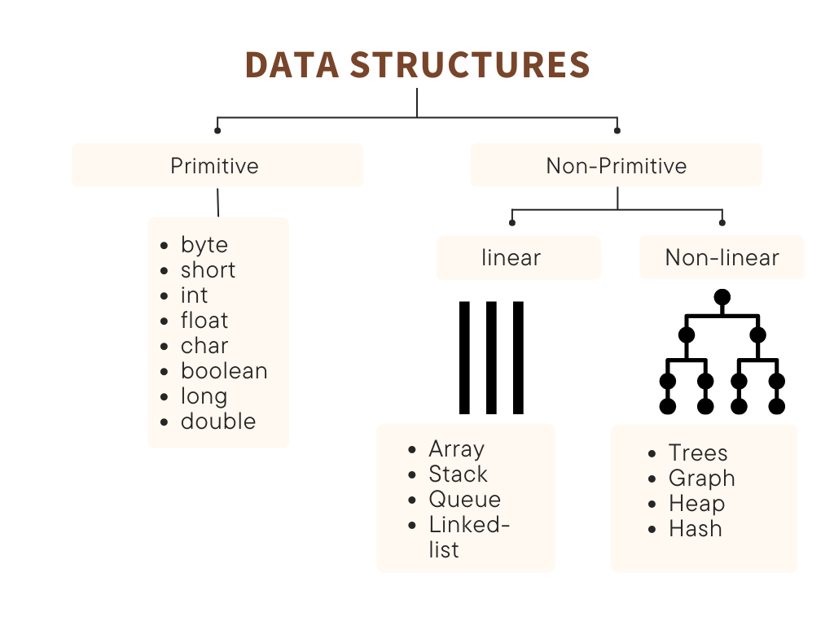
Data Structures (1/n)
The Java Collections Framework has a data structure that should work for virtually anything you’ll ever need to do.
A data structure is a storage that is used to store and organize data. It is a way of arranging data on a computer so that it can be accessed and updated efficiently.

Slide 4
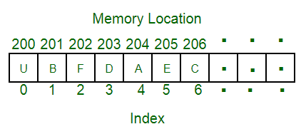
Data Structures (2/n)
Linear data structure: Data structure in which data elements are arranged sequentially or linearly, where each element is attached to its previous and next adjacent elements, is called a linear data structure. Examples of linear data structures are array, stack, queue, linked list, etc.
Static data structure: Static data structure has a fixed memory size. It is easier to access the elements in a static data structure. An example of this data structure is an array.
Dynamic data structure: In dynamic data structure, the size is not fixed. It can be randomly updated during the runtime which may be considered efficient concerning the memory (space) complexity of the code. Examples of this data structure are queue, stack, etc.

Slide 5
Data Structures (3/n)
Non-linear data structure: Data structures where data elements are not placed sequentially or linearly are called non-linear data structures. In a non-linear data structure, we can’t traverse all the elements in a single run only. Examples of non-linear data structures are trees and graphs.

Slide 6
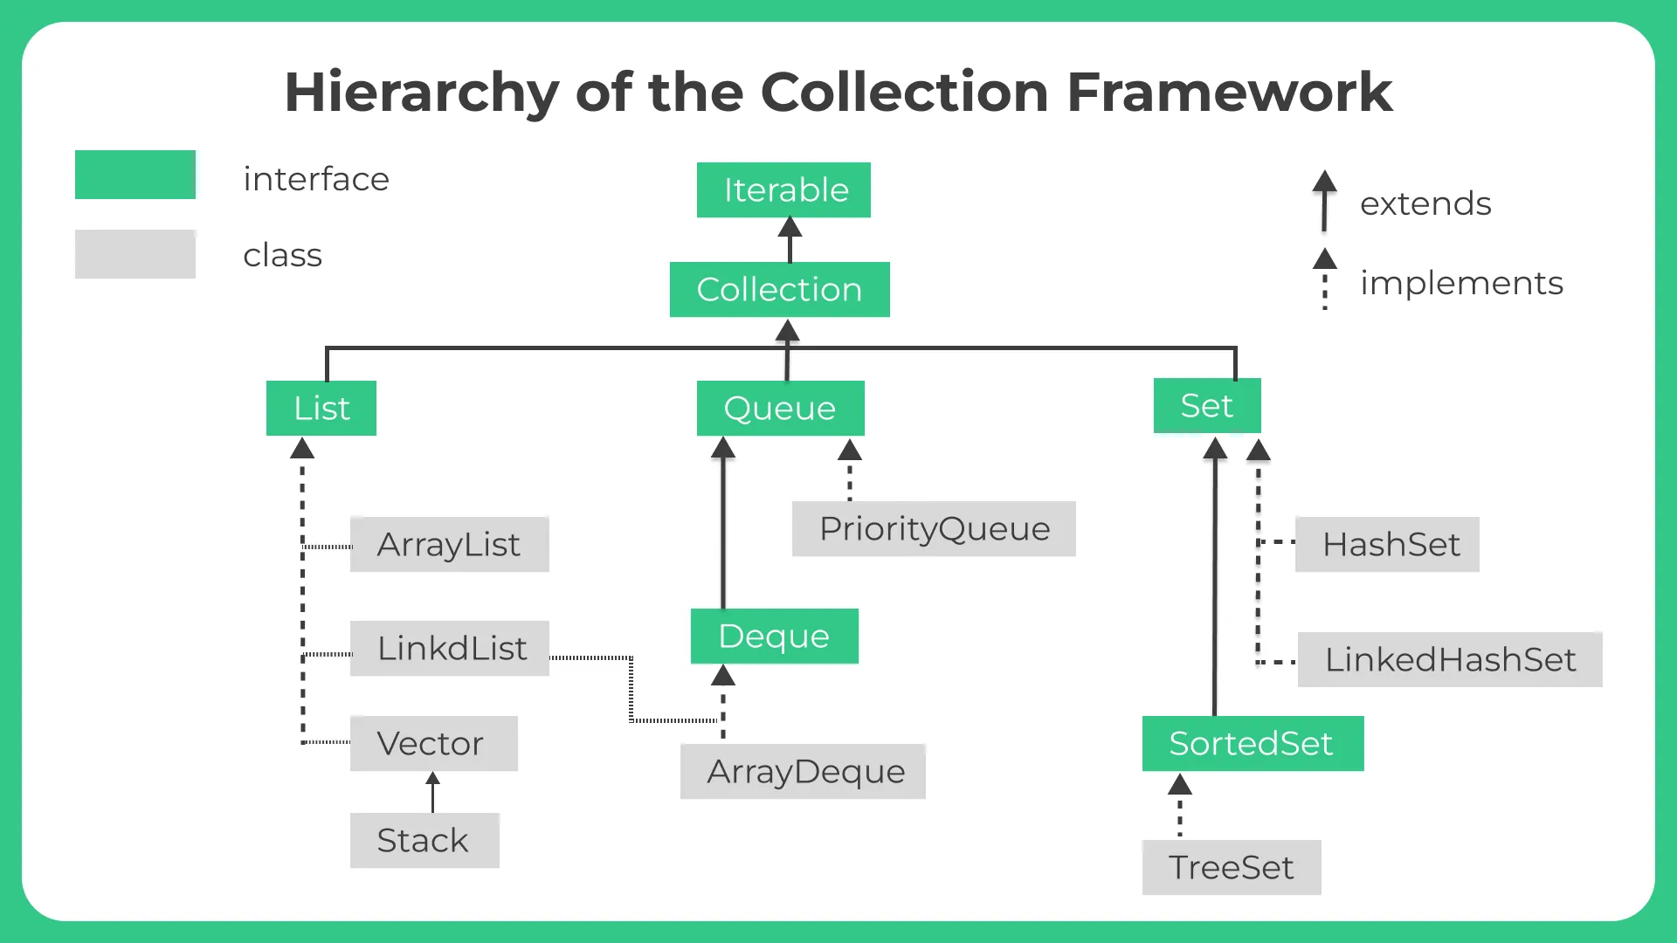
Collection Framework (1/n)
ArrayList is not the only collection
a TreeSet instead of an ArrayList, the Strings would automatically land in the right place, alphabetically sorted.

Slide 7
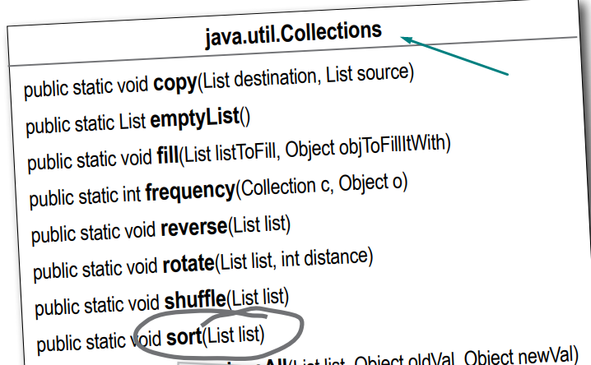
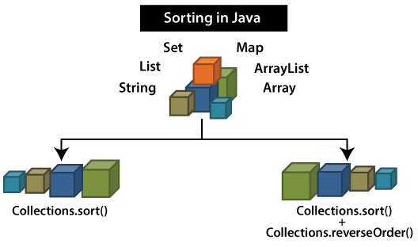
Collection Framework (2/n)
There IS a sort() method in the Collections class.
It takes a List, and since ArrayList implements the List interface, ArrayList IS-A List.
Thanks to polymorphism, you can pass an ArrayList to a method declared to take List.

Slide 8
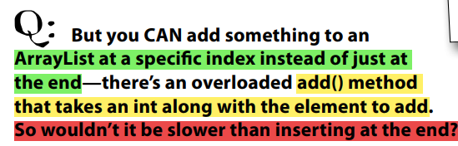
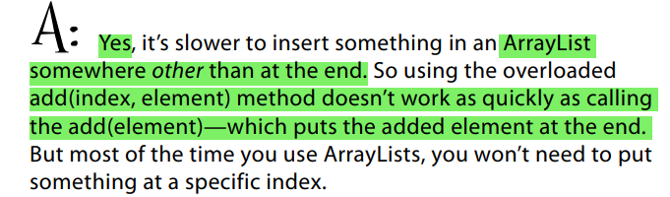
Collection Framework (3/n) - Array/ ArrayList
Array and ArrayList
public class SampleArray {
public static void main(String[] args) {
// Arrays
Integer[] number = new Integer[10];
for (int i=0; i<9; i++){
number[i]=i;
}
System.out.println(number[8]);
String[] gfg = new String[] { "G", "E", "E", "K", "S" };
System.out.println(gfg.length);
System.out.println(gfg);
}
}

Slide 9
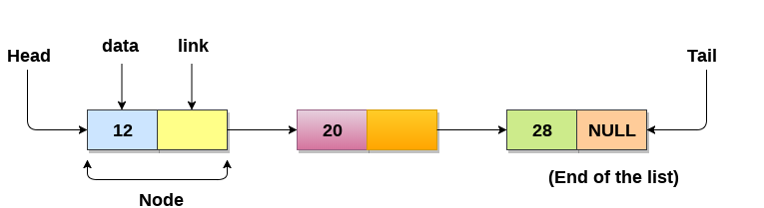
Collection Framework (4/n) - LinkedList
Firstly, a Linked List is a collection of things known as nodes that are kept in memory at random.
Secondly, a node has two fields: data saved at that specific address and a pointer to the next node in the memory.
The null pointer is contained in the list’s last node
public class Node {
int data;
Node next;
Node(int d){
data =d;
next = null;
}
}
Node Sample Code

Slide 10
Collection Framework (5/n) - LinkedList
a self-referential class in Java can be used to build a singly linked list of Java.
SinglyLinkedList that encloses an inner self-referential class Node that has two fields: an integer data field and a Node type “next” field. In addition, the outer class contains a reference/pointer/link to the HEAD of the document.
public class LinkedListExamples {
Node head; // head of list
public void display(){
Node n = head;
while (n!=null){
System.out.println(n.data + "\n");
n = n.next;
}
}
public static void main(String[] args) {
LinkedListExamples list = new LinkedListExamples();
list.head = new Node(100);
Node second = new Node(2);
Node third = new Node(332);
list.head.next = second;
second.next = third;
list.display();
}
}

Slide 11
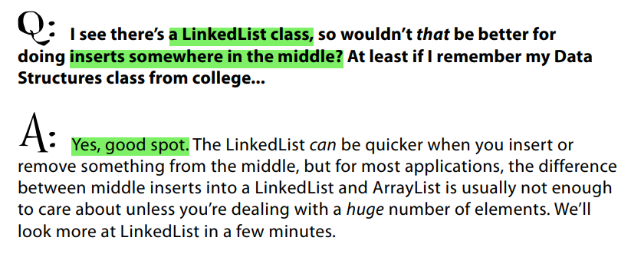
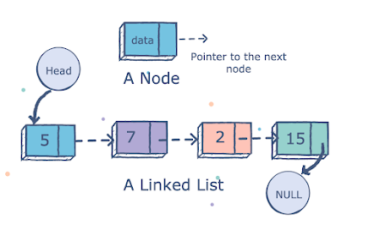
Collection Framework (6/n)

Slide 12
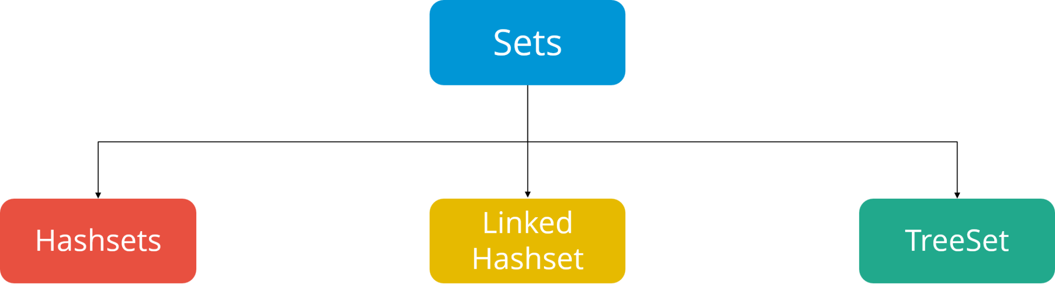
Collection Framework (7/n) - SET
The sorting all works, but now we have duplicates.
The sorted list contains duplicates.
Collections sort is a method of Java Collections class used to sort a list, which implements the List interface. All the elements in the list must be mutually comparable. If a list consists of string elements, then it will be sorted in alphabetical order.

Slide 13
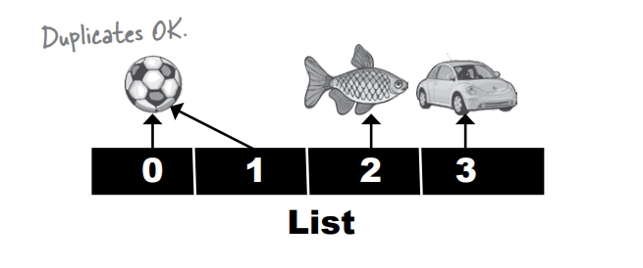
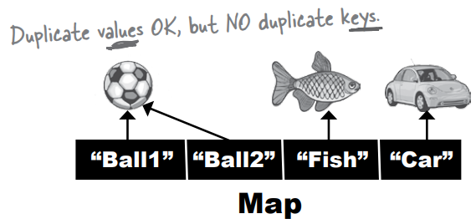
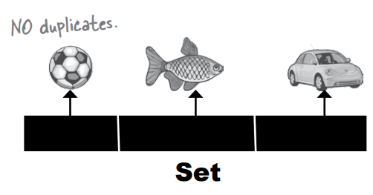
Collection Framework (8/n)
LIST - when sequence matters Collections that know about index position.
SET - when uniqueness matters Collections that do not allow duplicates.
MAP - when finding something by key matters Collections that use key-value pairs

Slide 14
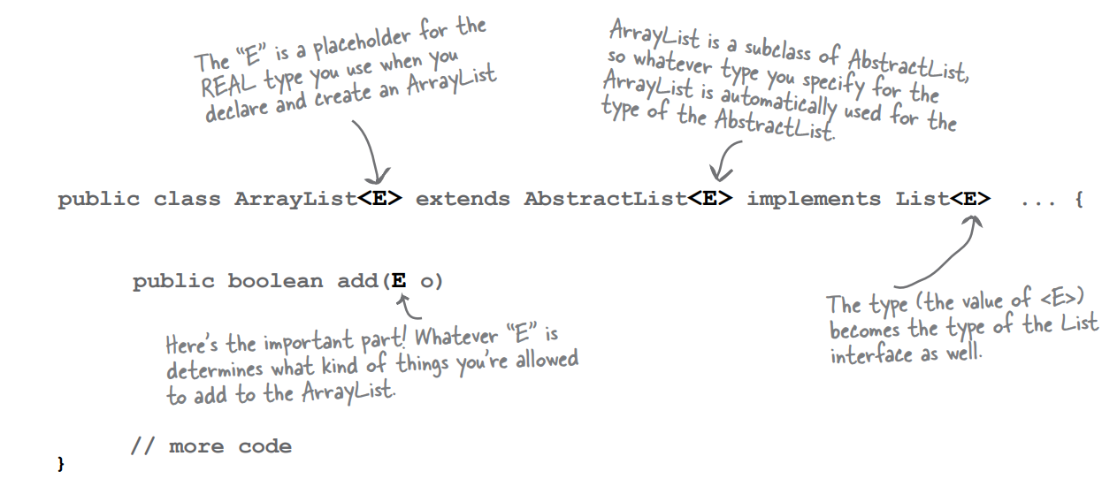
Generic Methods & Type (1/n)
We’ll just say it right here—virtually all of the code you write that deals with generics will be collection-related code.
Generics can be used in other ways, the main point of generics is to let you write type-safe collections.

Slide 15
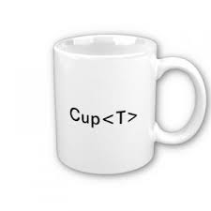
Generic Methods & Type (2/n)
Java Generic Type Naming convention helps us understanding code easily and having a naming convention is one of the best practices of Java programming language.
So generics also comes with its own naming conventions.
Usually, type parameter names are single, uppercase letters to make it easily distinguishable from java variables. The most commonly used type parameter names are: E – Element (used extensively by the Java Collections Framework, for example ArrayList, Set etc.)
K – Key (Used in Map) N – Number T – Type V – Value (Used in Map) S,U,V etc. – 2nd, 3rd, 4th types

Slide 16
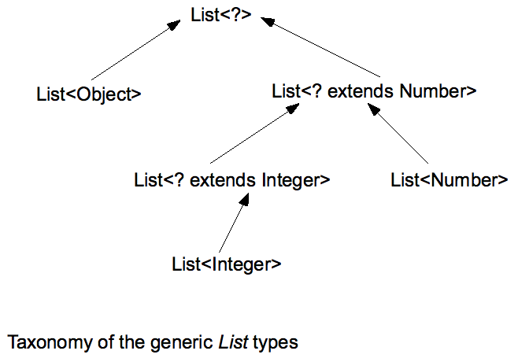
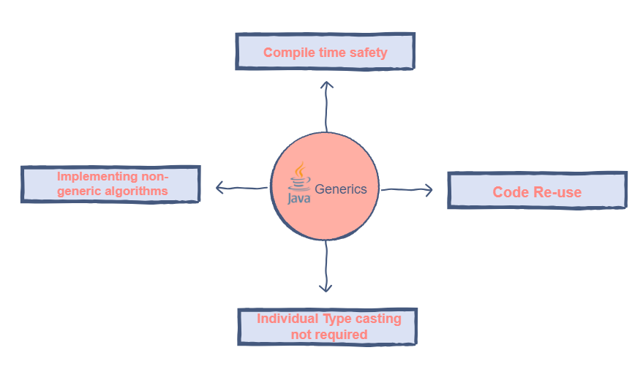
Generic Methods & Type (3/n)
Set<Object> setOfAnyType = new HashSet<Object>();
setOfAnyType.add("abc"); //legal
setOfAnyType.add(new Float(3.0f)); //legal - <Object> can accept any type

Slide 17
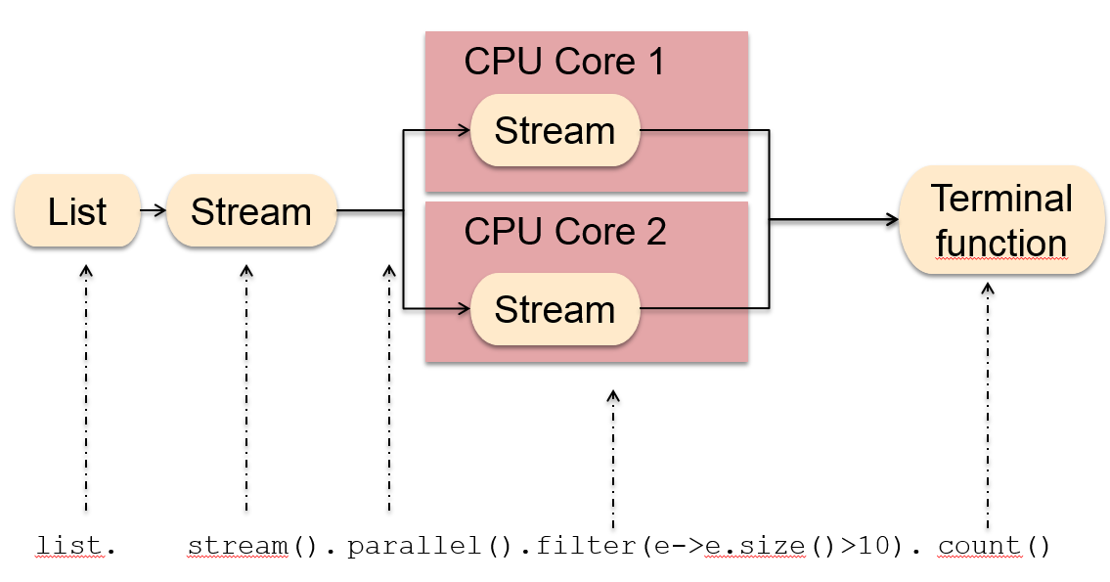
Stream API and CPU

Slide 18
Summary
Map interface doesn’t actually extend the Collection interface, but Map is still considered part of the “Collection Framework” (also known as the “Collection API”).
Using a HashSet instead of ArrayList

Slide 19
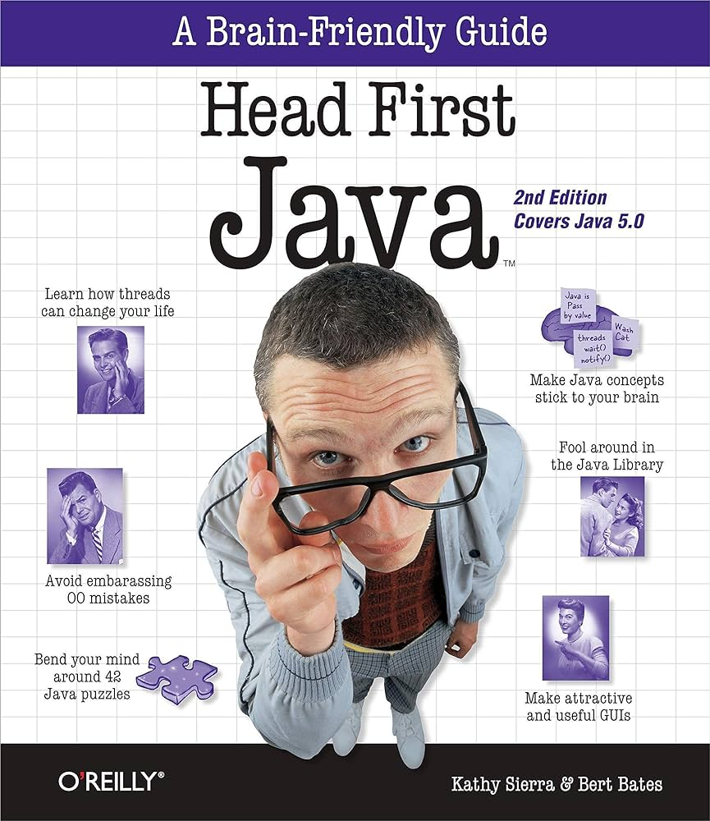
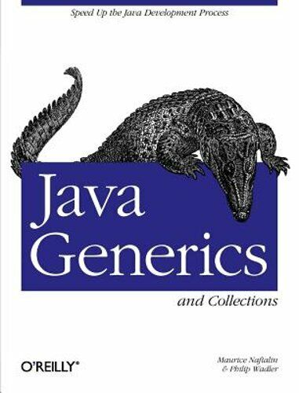
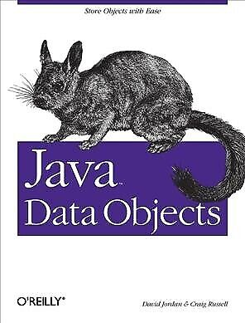
Reference Book

Slide 20
Reference Resources?
Head First (book)
Data Structure (resource)
Java Generics and Collections: Speed Up the Java Development Process by Naftalin
Java Generic Blog

Slide 21
Thank you!
Presented by
Hamdamboy Urunov
(hamdamboy.urunov@gmail.com)

